Slide 1



MFQ
Scheduler
Noora Amer | 2006056

Slide 2

Topics Covered
Team work
Project code
Agenda
Features and capabilities
Manual instruction to the program

Slide 3

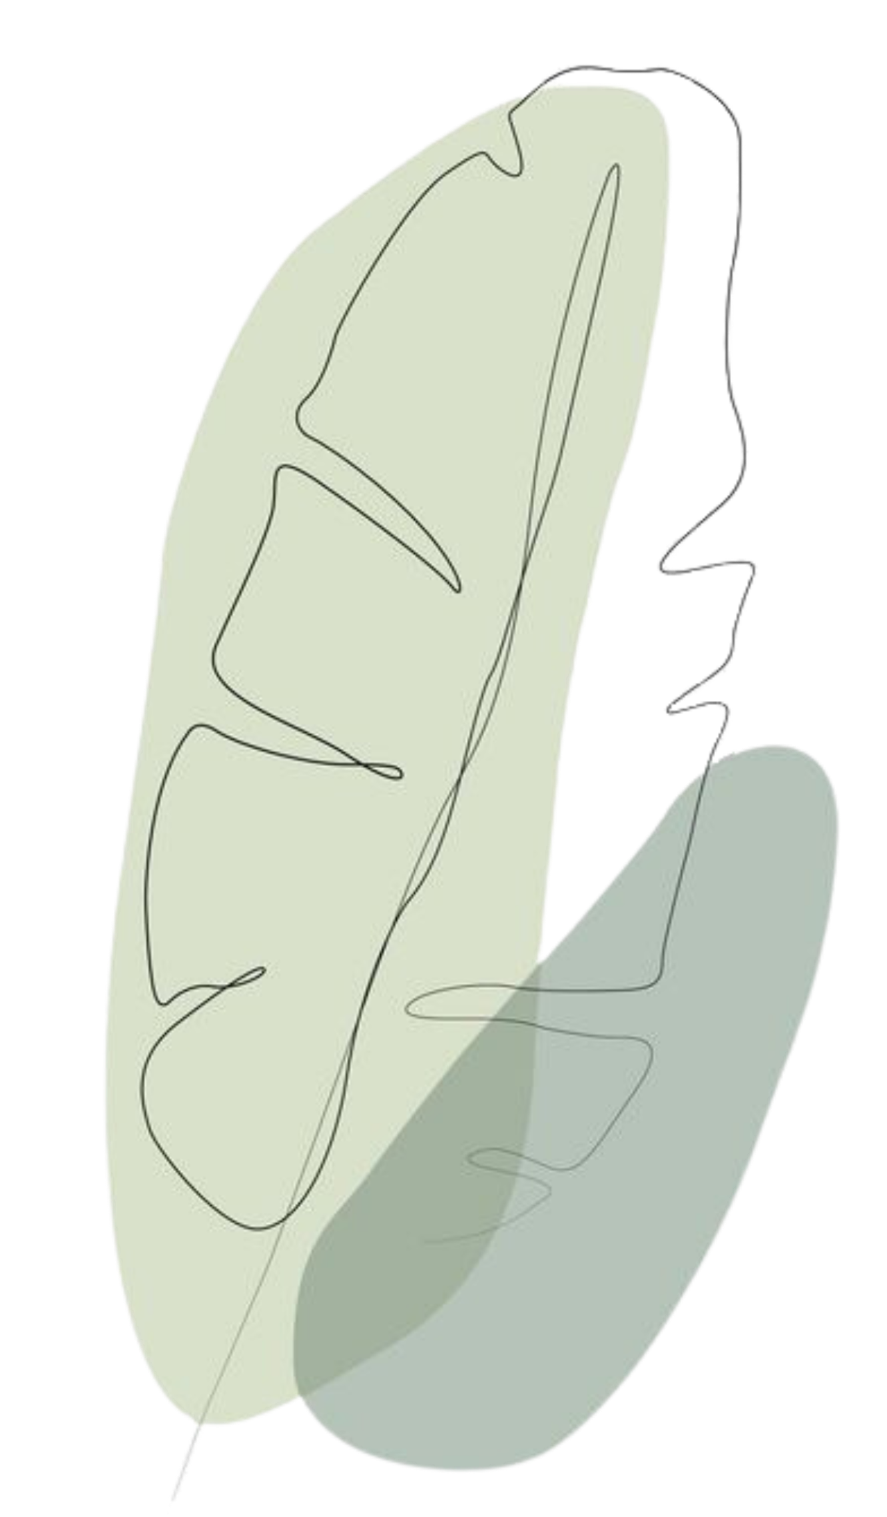
Teamwork:
Noora Amer | 2006056

Slide 4
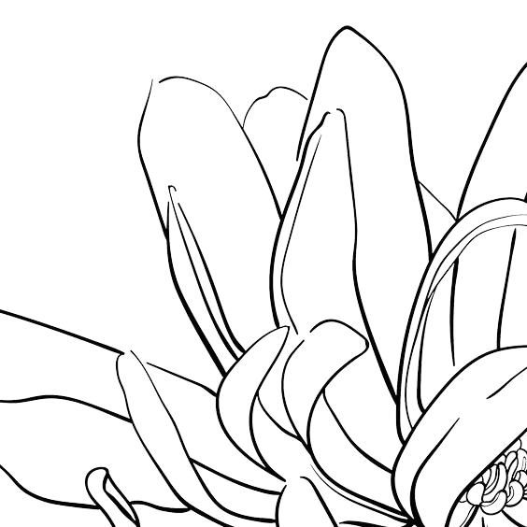
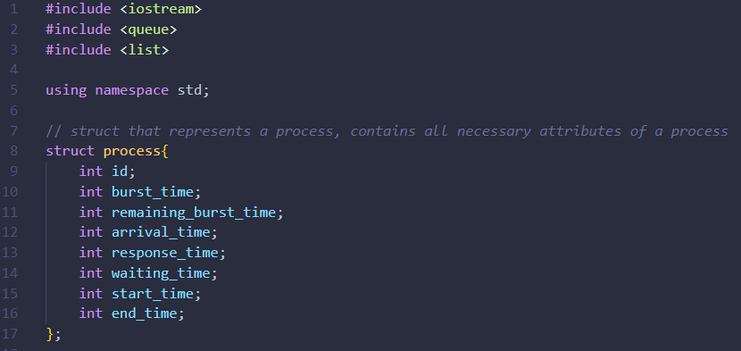
PCB structure
Project Code

Slide 5

PCB structure
main

Slide 6
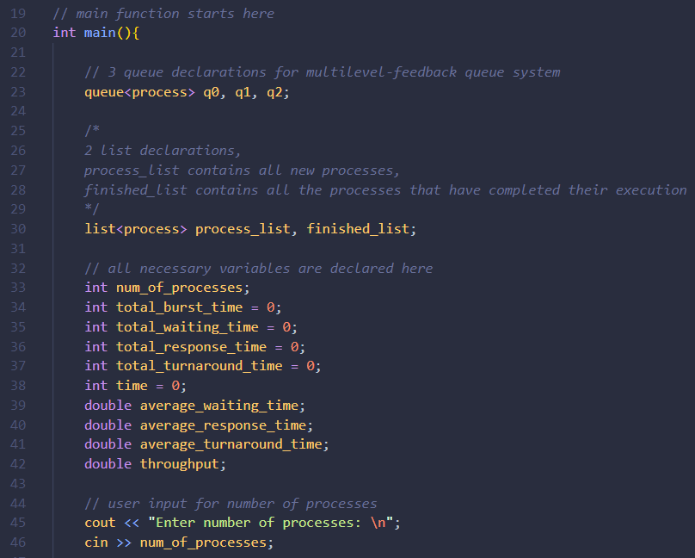
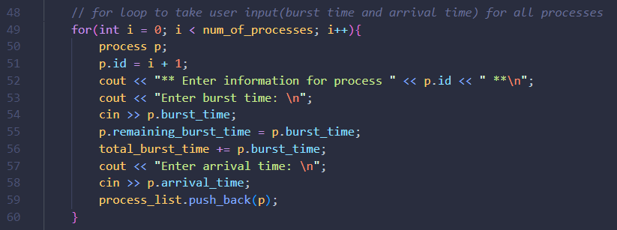
main
PCB structure

Slide 7
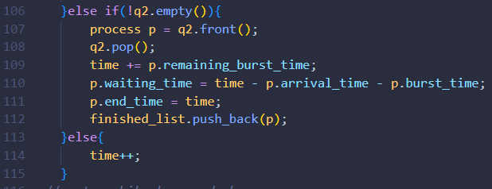
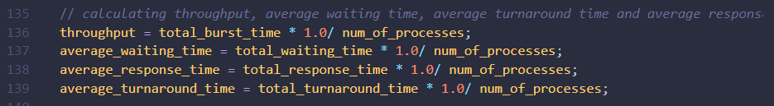
How it preform like a kernel
Q0 = 8 and Q1 = 16 demo explanation

Slide 8
Almost done !
Q3 = FCFS
calculations after all work is done will be here

Slide 9

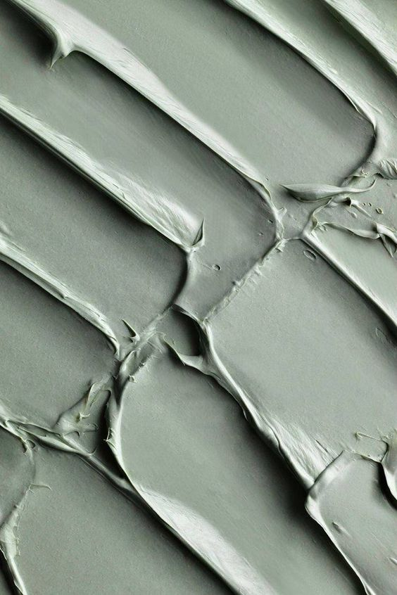
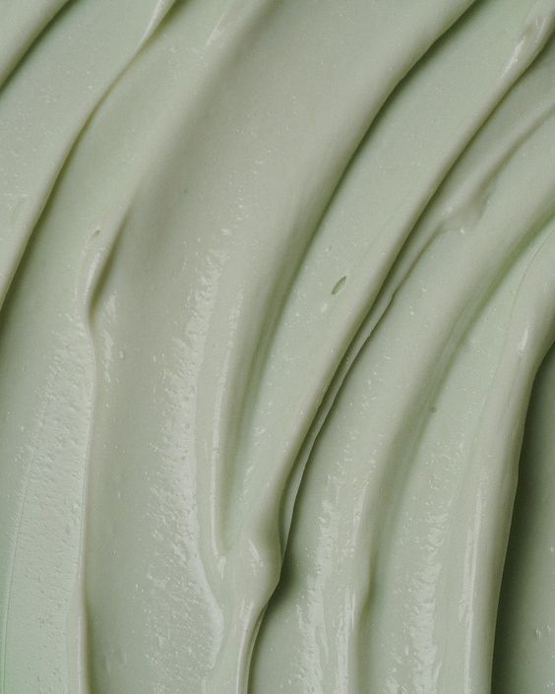

CPP Methods
Features and capabilities of project
QEUES
LINKED LIST
STRUCT
To help order the process through different quantum
Help to order the process and track behavior of burst time and arrival time
To help gather every process information and easy to manipulate them
— Code features

Slide 10
CPP Methods
QEUES
LINKED LIST
STRUCT
To help order the process through different quantum
Help to order the process and track behavior of burst time and arrival time
To help gather every process information and easy to manipulate them

Slide 11

Solving a Problem
A sample of using and calculating a problem using Multi Level Feedback Scheduling

Slide 12


Problem :
Turn Around Time = End – Arrival time
Waiting Time = Turn Around – Burst time
Process
Burst time
Arrival time
Start
End
Turn Around
Waiting time
P1
15
0
0
39
39
24
P2
20
3
8
51
48
28
P3
9
4
16
52
48
39
P4
27
7
24
71
64
37
Q0 = 8 RR
P4
P3
P2
P1
Q1 = 16 RR
P4
P3
P2
P1
Q2 = FCFS
P4
32
24
16
8
0
68
52
51
39
32
71
68

Slide 13
Calculating outputs
Average Waiting Time = (24+28+39+37) / 4 = 32
Average Turn Around Time = (39+48+48+64) / 4 = 49.75
Throughput = (15+20+9+27) / 4 = 17.75
Average Response = (0+8+16+24) / 4 = 12

Slide 14

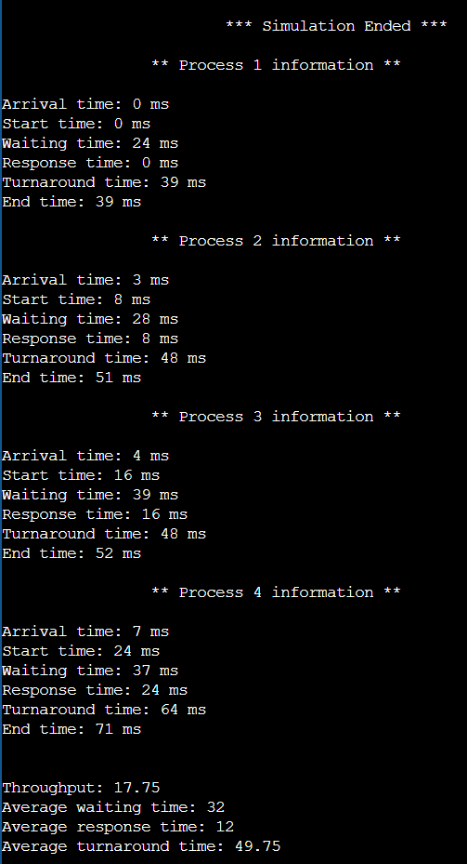
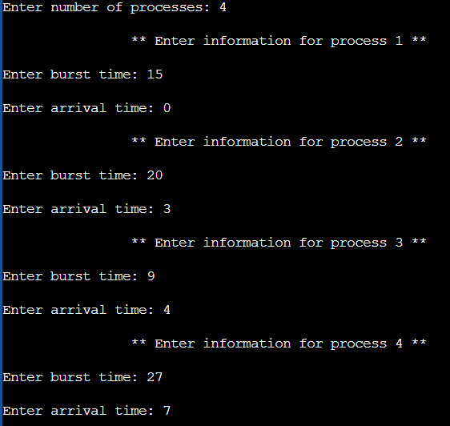
Picture of the Problem output:
Take a look !
Using the problem explained before in the program

Slide 15
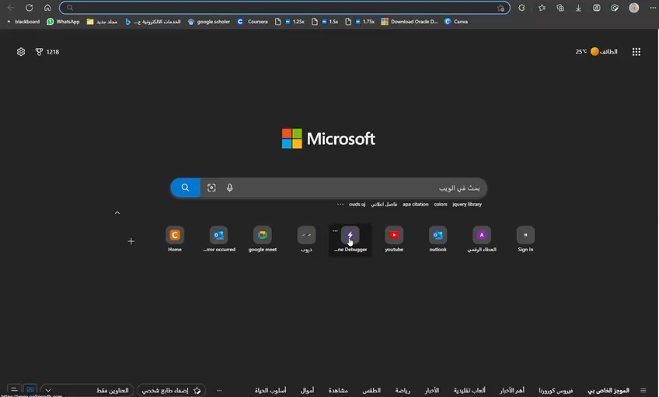

User Guide:
A short video of how to use the program

Slide 16

Thank you!
Any further questions ?

Slide 17











Resource
Page
Use these design resources in your Canva Presentation. Happy designing!
Don't forget to delete this page
before presenting.

Slide 18





























Resource
Page
Use these design resources in your Canva Presentation. Happy designing!
Don't forget to delete this page
before presenting.

Slide 19
Resource
Page
B for blur
C for confetti
Find the magic and fun in presenting with Canva Presentations.
Press the following keys while on Present mode!
Don't forget to delete this page
before presenting.
D for a drumroll
O for bubbles
Q for quiet
X to close
Any number from 0-9
for a timer

